Slide 1
CSE 2211 - Database Management Systems - I Lab
Project Name:
Medical Supply Management System
Members :
01. Mehedi Hasan Sakib (13)
02. Ruhul Amin (27)
28th Batch
Department of Computer Science and Engineering
University of Dhaka

Slide 2
Introduction
What is this project about?
A database system to manage pharmacies, medicines, and transactions efficiently.
Purpose of the project:
Organize and streamline pharmacy data management.
Maintain accurate medicine inventory.
Log transactions and updates systematically.

Slide 3
Objectives,Features & Benefits
Objectives :
Maintain structured pharmacy data
Track medicine inventory
Log transactions and updates
Ensure data integrity and security
Features & Benefits :
Why is this system useful? ✅ Organized pharmacy records ✅ Quick medicine search ✅ Automated logs & tracking ✅ Data consistency with relationships

Slide 4
Database Schema Overview
The database consists of five tables:
POSTS (Medical Store Information)
MEDICINES (Medicine & Product Details)
LOGS (Action Logs for Transactions)
ADDMP (Additional Medicines)
ADDPD (Additional Products)

Slide 5
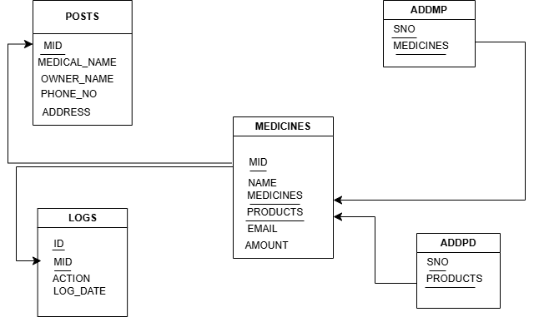
Schema Diagram

Slide 6
TABLE - POSTS
Purpose: Stores details about medical facilities or businesses involved in the pharmaceutical supply chain.
Attributes:
MID (INT, Primary Key): Unique identifier for each medical entity.
MEDICAL_NAME (VARCHAR(255), NOT NULL): Name of the medical facility.
OWNER_NAME (VARCHAR(255)): Name of the owner of the medical facility.
PHONE_NO (VARCHAR(15)): Contact phone number of the facility.
ADDRESS (VARCHAR(255)): Address/location of the medical facility.

Slide 7
TABLE - MEDICINES
Purpose: Manages information about medicines and products offered by medical entities.
Attributes:
MID (INT, Primary Key, Foreign Key referencing POSTS(MID)): Links medicines to a specific medical entity.
NAME (VARCHAR(255), NOT NULL): Name of the medical facility or related entity.
MEDICINES (VARCHAR(255)): List or description of medicines offered.
PRODUCTS (VARCHAR(255)): List or description of additional products.
EMAIL (VARCHAR(255)): Contact email address.
AMOUNT (DECIMAL(10, 2)): Price or amount of products/medicines.

Slide 8
Table - LOGS
Purpose: Maintains records of actions or events for audit and monitoring purposes.
Attributes:
ID (INT, Primary Key, NOT NULL): Unique identifier for each log entry.
MID (INT, Foreign Key referencing POSTS(MID)): Links the log entry to a specific medical entity.
ACTION (VARCHAR(255), NOT NULL): Description of the action performed.
LOG_DATE (DATE, NOT NULL): Date of the action logged.

Slide 9
TABLE - ADDMP
Purpose: Stores additional information related to medicines.
Attributes:
SNO (INT, Primary Key, NOT NULL): Unique identifier for the entry.
MEDICINES (VARCHAR(255), NOT NULL): Description or details of additional medicines.
TABLE - ADDPD
Purpose: Stores additional information related to products.
Attributes:
SNO (INT, Primary Key, NOT NULL): Unique identifier for the entry.
PRODUCTS (VARCHAR(255), NOT NULL): Description or details of additional products.

Slide 10
Entity-Relationship (ER) Diagram
Visual representation of database relationships:
POSTS (Medical Store Information) is the main entity.
MEDICINES table links to POSTS via MID (Foreign Key).
LOGS table logs actions on medical stores, linked by MID.
ADDMP and ADDPD store additional medicines and products but remain independent.
Example ER Diagram Explanation:
One medical store (POSTS) can have multiple medicines (MEDICINES table).
One medical store (POSTS) can have multiple log entries (LOGS table).
ADDMP and ADDPD provide extra categorizations but do not directly link to POSTS.

Slide 11
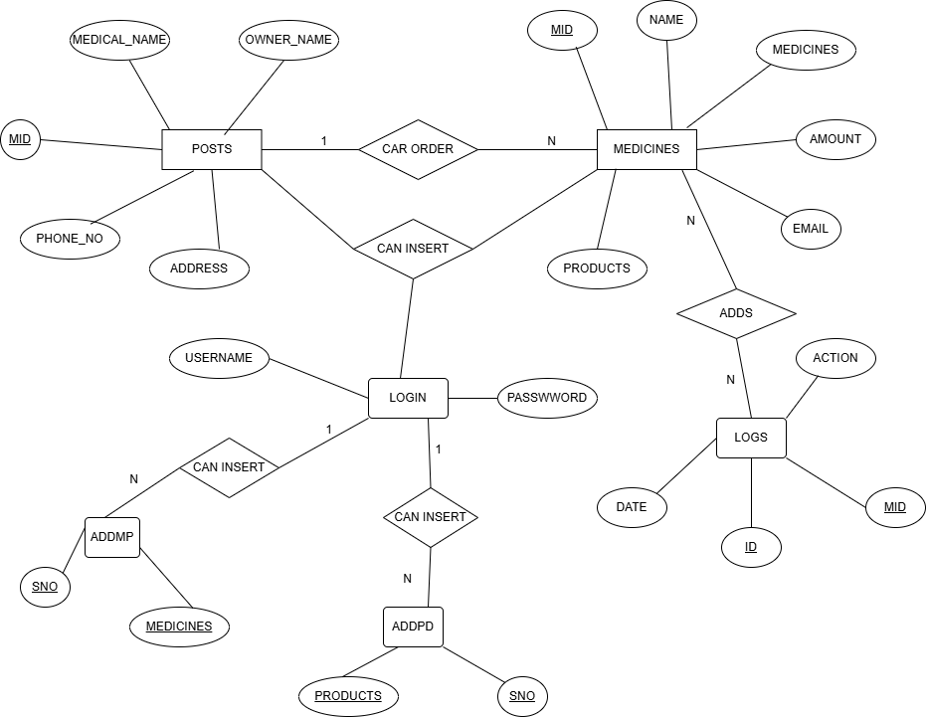
Entity-Relationship (ER) Diagram

Slide 12
Table Create
CREATE TABLE POSTS (
MID INT PRIMARY KEY,
MEDICAL_NAME VARCHAR(255) NOT NULL,
OWNER_NAME VARCHAR(255),
PHONE_NO VARCHAR(15),
ADDRESS VARCHAR(255)
);
CREATE TABLE LOGS (
ID INT NOT NULL PRIMARY KEY,
MID INT,
ACTION VARCHAR(255) NOT NULL,
LOG_DATE DATE NOT NULL,
CONSTRAINT FK_MID FOREIGN KEY (MID) REFERENCES POSTS(MID)
);

Slide 13
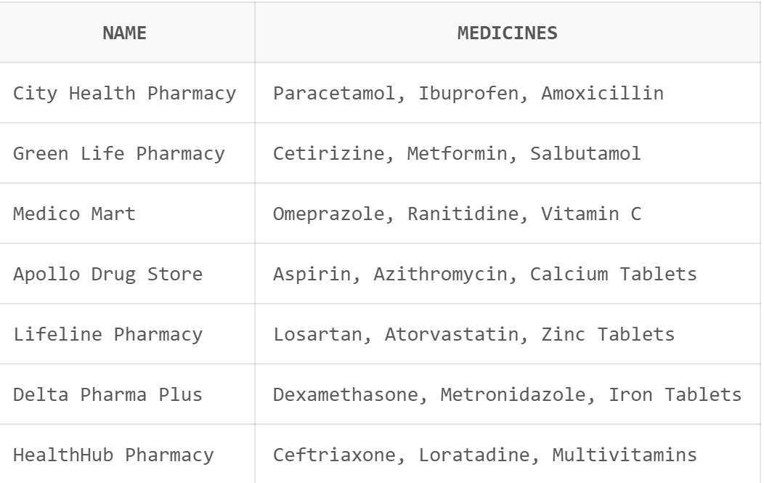
SQL Queries Example
Find all medicines and their corresponding pharmacy names?
SELECT NAME, MEDICINES FROM MEDICINES;

Slide 14
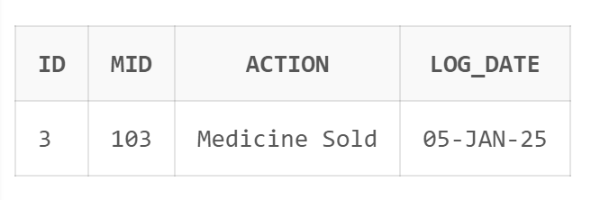
Get logs of a specific pharmacy (e.g., MID = 103)?
SELECT * FROM LOGS WHERE MID = 103;

Slide 15
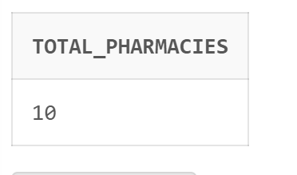
Count the number of pharmacies in the database?
SELECT COUNT(*) AS Total_Pharmacies
FROM POSTS;

Slide 16
Conclusion
This database effectively manages medical store records.
Implements data integrity using primary and foreign keys.
Can be expanded to include more functionalities.

Slide 17


Slide 18
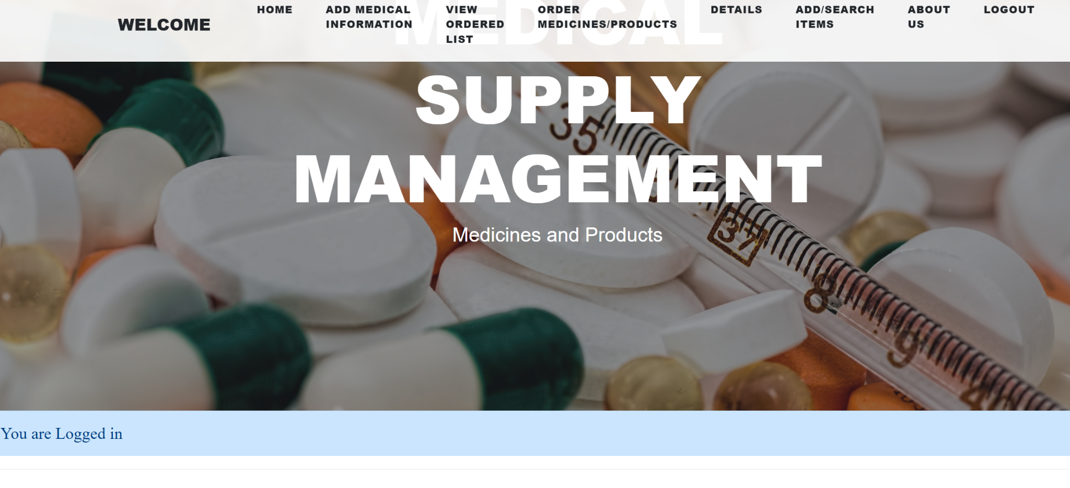

Slide 19
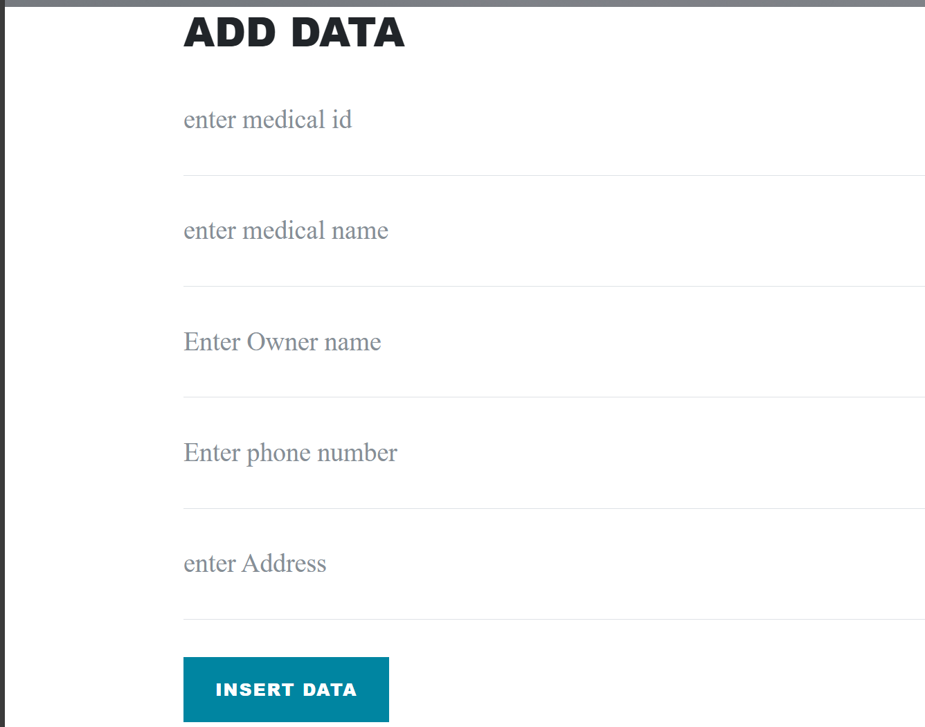

Slide 20


Slide 21

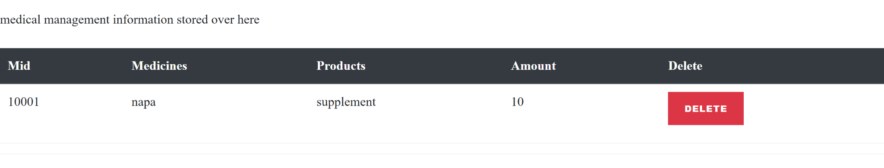

Slide 22
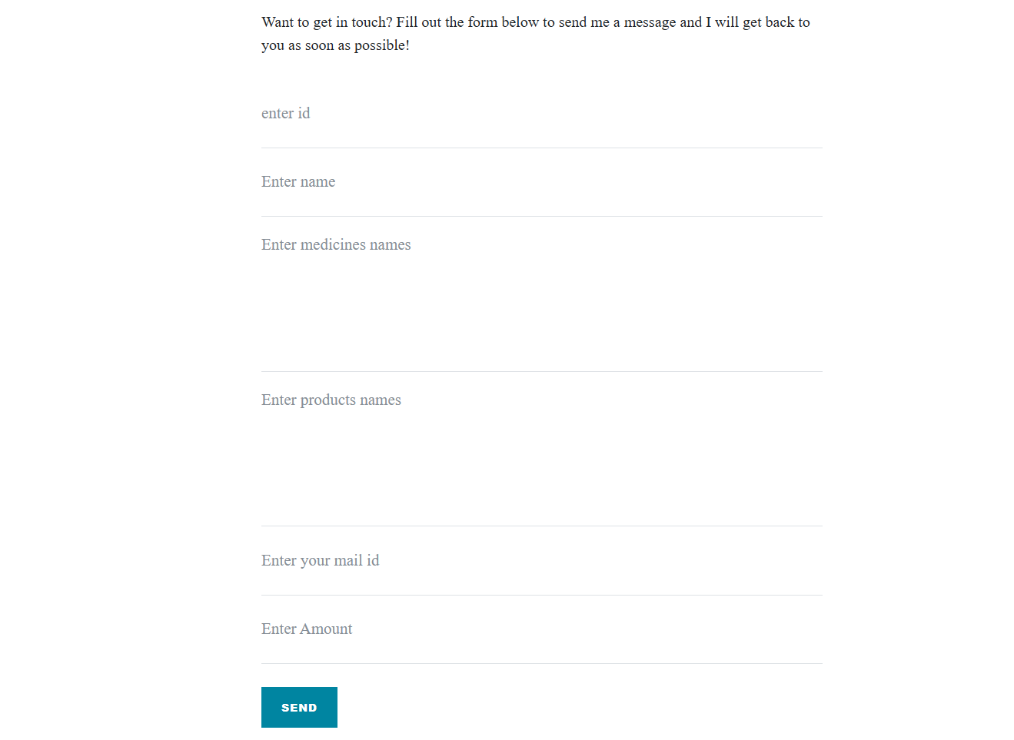

Slide 23
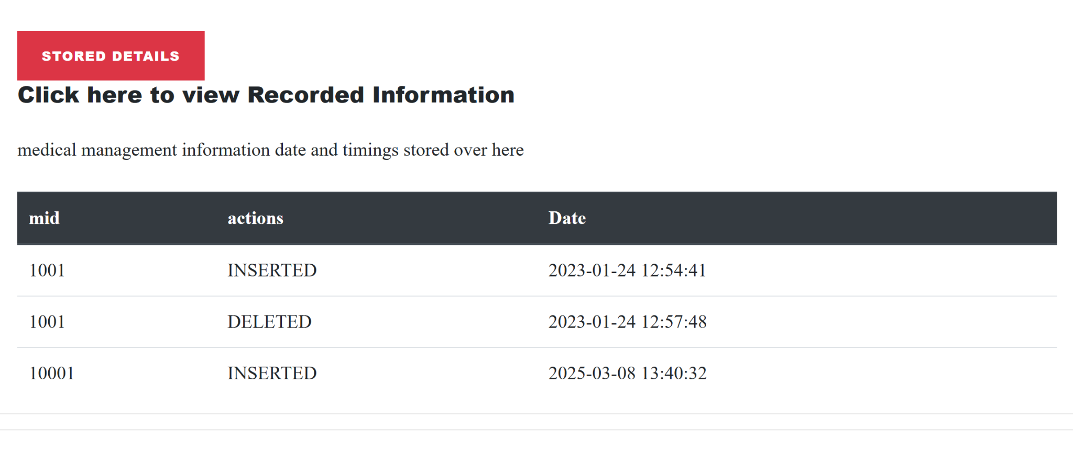

Slide 24

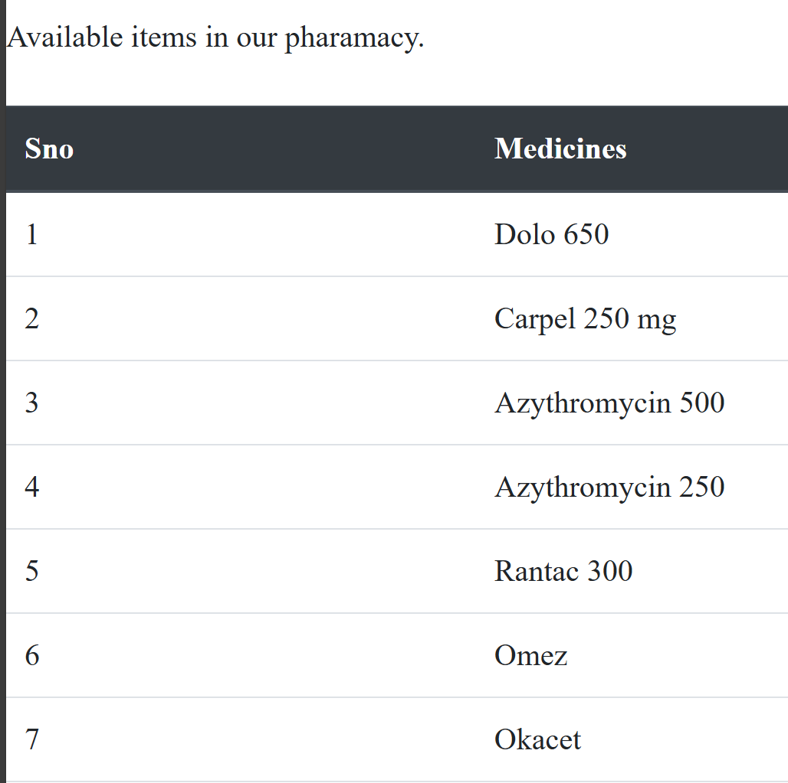

Slide 25

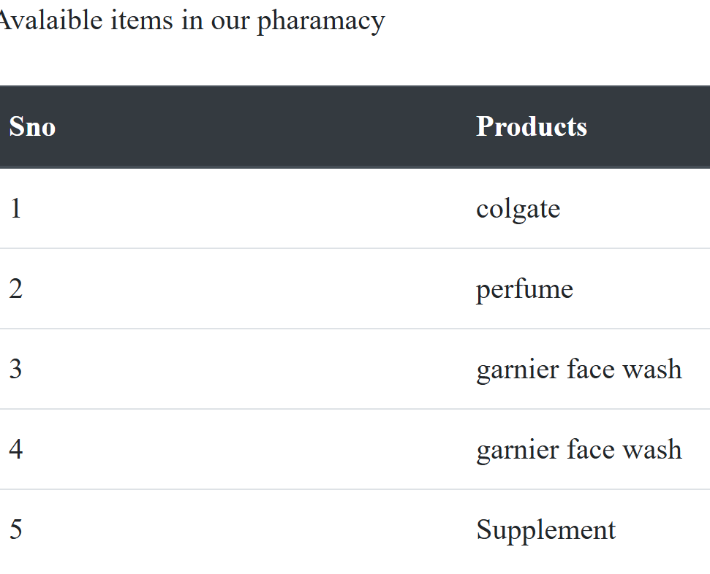

Slide 26

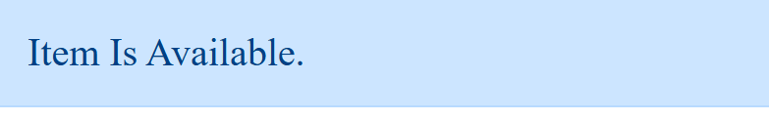

Slide 27
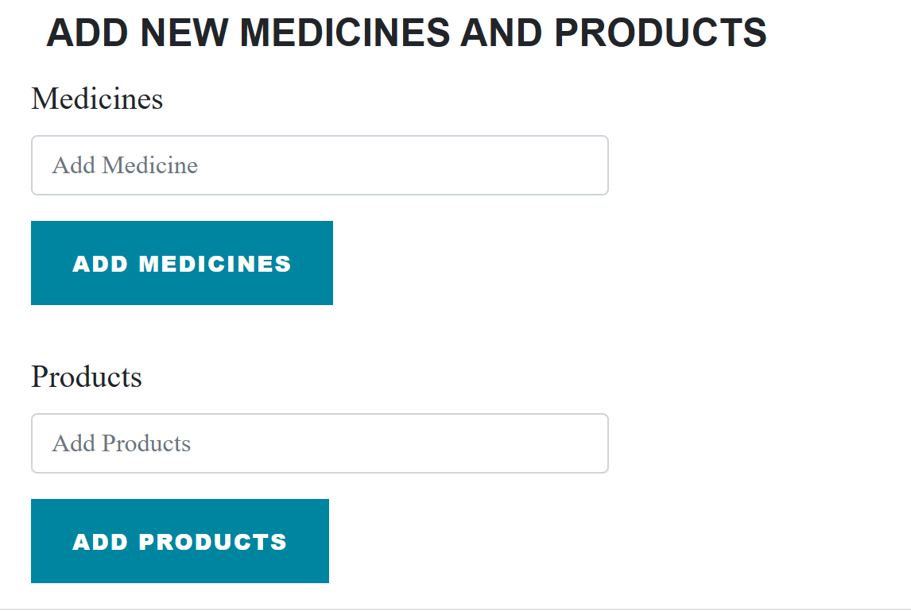

Slide 28
Questions & Feedback?

Slide 29
Thank You!

